Slide 1
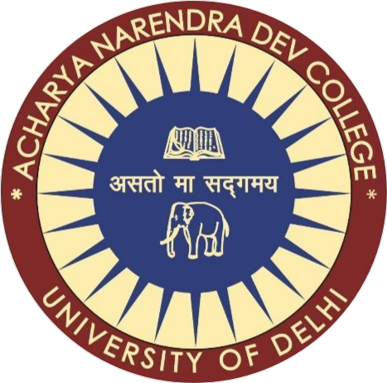
DUAL AXIS SOLAR TRACKING SYSTEM

Slide 2
DUAL AXIS SOLAR TRACKING SYSTEM
Himanshu verma, Ankit, vedant
Acharya Narendra Dev College , University Of Delhi
Guide – PROF. Manisha kaurana
Internet of things
Department of Electronics Science

Slide 3
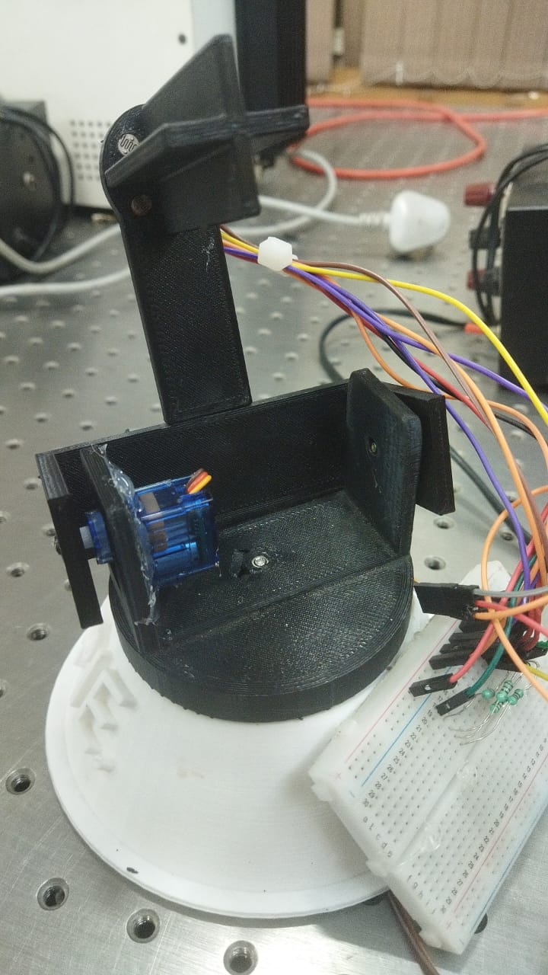
Introduction
The Dual Axis Solar Tracking System is designed to maximize the efficiency of solar panels by constantly aligning them with the direction of the sunlight. This system uses Light Dependent Resistors (LDRs) to detect the position of the sun and servo motors to adjust the panel’s orientation accordingly on both horizontal and vertical axes. By tracking the sun’s movement throughout the day, the system increases solar energy absorption compared to fixed solar panels. This automation not only boosts power generation but also showcases an efficient use of sensors and actuators for sustainable energy solutions.

Slide 4
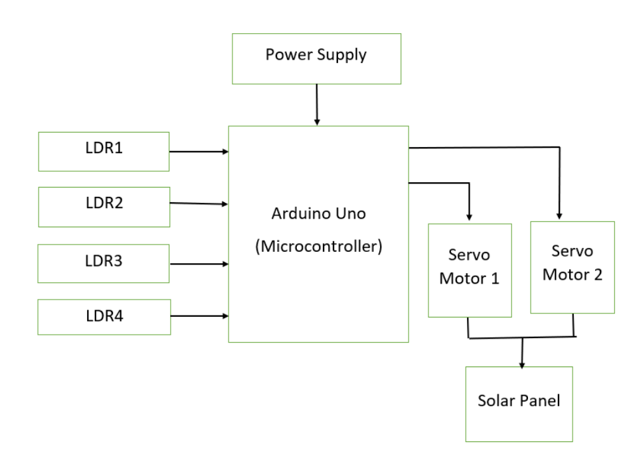
Working principle of DUAL AXIS SOLAR TRACKING SYSTEM
The project basically works on the principle of reducing of resistance value of LDR when light falls on it.
By taking the difference in the values of different LDR fixed on different partition walls we will able to find the rotation direction and angle in 360 degree to get the max intensity adjustments for the power production of electricity.

Slide 5
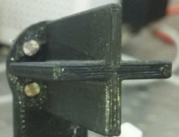
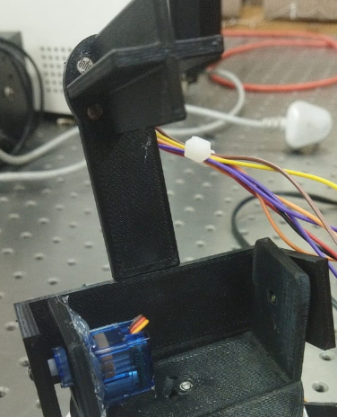
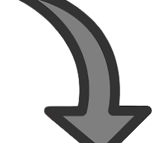
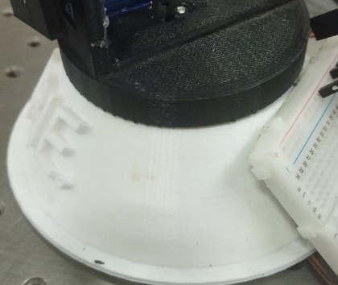

mechanism
A0
A3
Compare the difference in the intensity of the left LDRs with the difference in the intensity of the right LDRs.
A1
A2
int diff_of_diffs = abs(diff_left - diff_right);
LEFT LDR’s A0 > A1 MOVE UPWARD,
RIGHT LDR’s A3 > A2 MOVE UPWARD
int diff_left = abs(LDR_left - LDR_left2);
int diff_right = abs(LDR_right - LDR_right2);

Slide 6
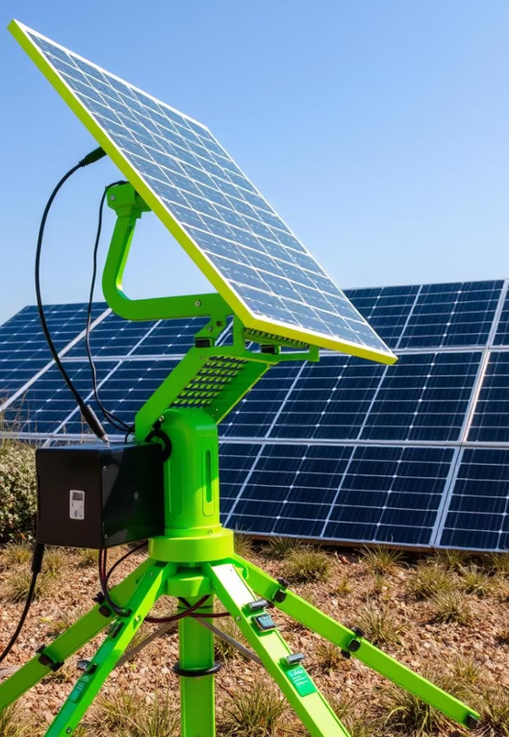
Applications
Solar Power Plants : Dual axis trackers are used in large-scale solar farms to maximize energy output by continuously aligning solar panels with the sun.
Street Lighting Systems : Used in solar-powered street lights to ensure the battery charges efficiently throughout the day.
Space Applications : Satellites and space probes use dual axis tracking to keep solar panels aligned with the sun for maximum power.
Agricultural Irrigation Systems : Solar-powered irrigation systems can benefit from improved energy capture using dual axis tracking.

Slide 7
Advantages
✅ Enhanced Energy Output: Increases solar panel efficiency by up to 40% by continuously aligning with the sun.
🔄 Real-Time Sun Tracking: Dual axis movement ensures optimal angle throughout the day and across seasons.
⚙️ Automated Operation: Uses LDR sensors and servo motors for precise, hands-free adjustment—no manual repositioning needed.
☁️ Adaptable to Weather Changes: Dynamically adjusts position even during partially cloudy conditions to maximize light absorption.
💡Efficient Use of Panel Area: Delivers more energy per panel, reducing the need for larger panel arrays.

Slide 8
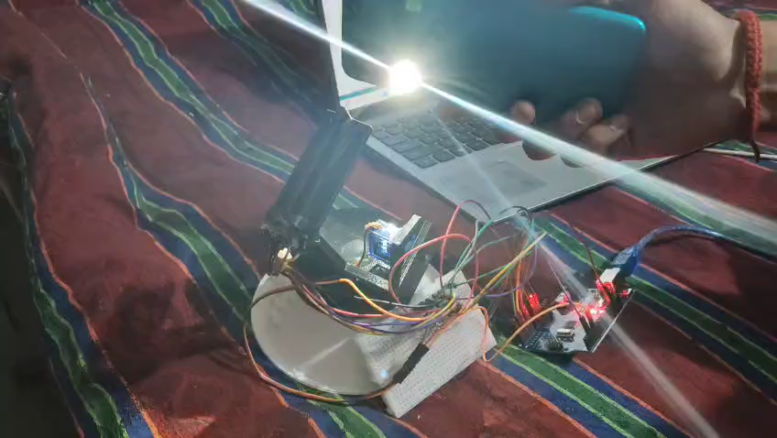
Working video

Slide 9
THANK YOU

